Slide 1
Year 5 Parents’ Meeting – 2026/27
Year 5: Mr Game and Miss Taj
Learning Mentors: Mrs Gill, Mr Khan
SENDCo: Miss King
Senior Leadership: Mrs Khan, Mr Malcolm

Slide 2
Morning Timetable
8:45 In the line at the front of school
8:50 – 9:00 Register + Early Work
9:00 – 9:15 Assembly/MyHappyMind/Maths Meeting
9:15 – 10:15 Reading
10:15 – 11:10 Writing
11:10 – 11:25 Playtime
11:30 – 12:30 Mathematics

Slide 3
Afternoon Timetable
Music PE – Tuesday and Friday
Computing Spanish
Science Geography
RE History
SPaG PATHS

Slide 4
Year 5 Humanities
Autumn 1 Economic activity in Bournville
Autumn 2 Baghdad & the Islamic Golden Age
Spring 1 The Changing Power of the British Monarchy
Spring 2 Threats to our Environment
Summer 1 Impact of the Railways in Britain
Summer 2 Geography of North America

Slide 5
English
Writing:
Narratives, letter, diary, poetry, report and play script
Reading:
Charlie and the Chocolate Factory
One Thousand and One Arabian Nights
Robin Hood
The Railway Children
Percy Jackson and the Lightning Thief

Slide 6
Homework
Reading (diaries/records) – hand in on Tuesday with FIVE entries or more
Spellings – test every Friday
Handwriting practice
English & Maths – Friday
Research/project tasks when appropriate

Slide 7
UNIFORM
Please ensure that your child is wearing a full school uniform every day including BLACK SHOES.
Please ensure your child comes in PE kit on PE days (white t-shirt, black shorts, leggings or track suit, pumps, trainers – no football shirts).
Remember: no earrings on PE days (Tuesday and Friday).
NO jewellery except stud earrings and simple watches.
Dressing up days will be announced through the year.
End of term – expectations continue until the final day of term in July.
Please provide your child with a bottle of PLAIN water for during the school day. Children cannot refill their bottle in school.

Slide 8
TRIPS and WORKSHOPS
Balsall Heath library
Central Mosque
Healthy Living Workshop
Parent workshops – Maths and English
Swimming

Slide 9
Park Hill - Rights and Values
British Values
UNICEF – Gold Award
Park Hill Values

Slide 10
Park Hill - British Values
Democracy – the ability to vote for our laws and political leaders and to become political leaders and make laws ourselves too.
Individual Liberty – we choose how to live our lives, make our own mistakes but also face our own consequences too.
Rule of Law – this has been made by British society over many years and reflects our values. We live within the law but can also challenge it and expect a fair trial if we break it.
Mutual Respect – everyone is entitled to their own lifestyle and politics – so long as they don’t encourage extremism as that goes against mutual respect and law.
Tolerance of those of different faiths - everyone is entitled to their own faiths, non-religious world views and beliefs

Slide 11

UNICEF Rights Respecting School Award
Here at Park Hill, we are a Gold UNICEF Rights Respecting School. We put the UN Convention for the Rights of the Child (UNCRC) at the heart of our school ethos and culture to improve well-being and develop every child’s talents and abilities to their full potential. Our children and the school community learn about children’s rights and how to put them into practice every day.
Each class has learned about the UN Convention for the Rights of the Child (UNCRC) and created a class charter.
You can find out more about the UNCRC at https://www.unicef.org.uk/what-we-do/un-convention-child-rights/?gclid=CPHVpv3iqNQCFU0Q0wodS9oCGg&sissr=1

Slide 12
Park Hill - Rights and Values
Park Hill Values:
Aspiration, Community, Compassion,
Equality, Resilience, Respect
Recognised and celebrated throughout school life and in Merit Assembly

Slide 13
Wellbeing – PATHS & MyHappyMind
Focus on self-development and relationships

Slide 14
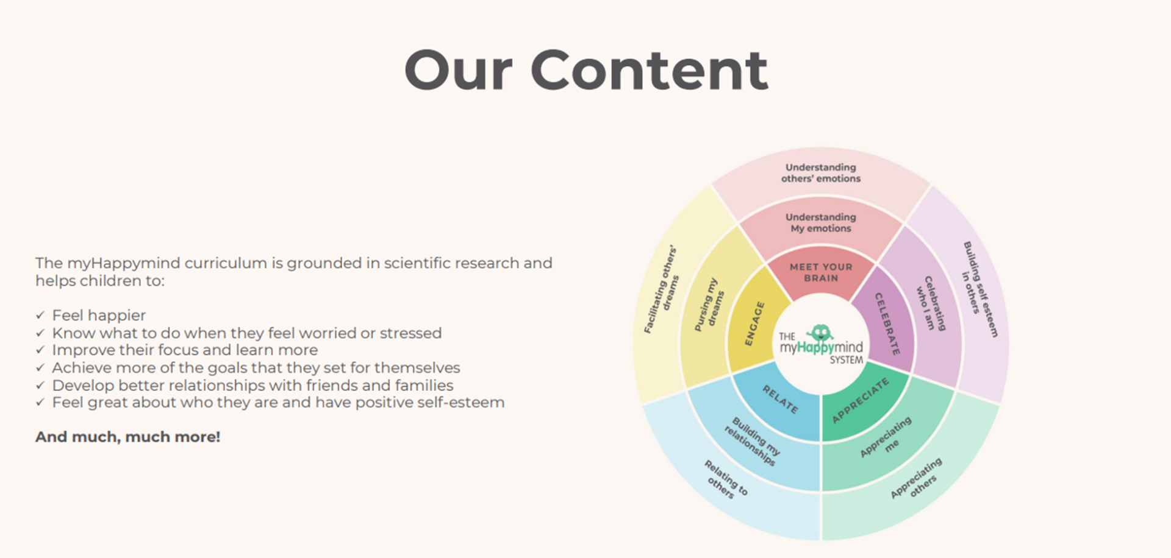

Slide 15
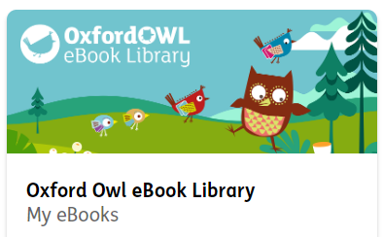


Technology

Slide 16
Photo permission
Books / Instagram
Why?
To create a record of learning
To promote the school
To build a presence in the local community
To share successes with parents

Slide 17
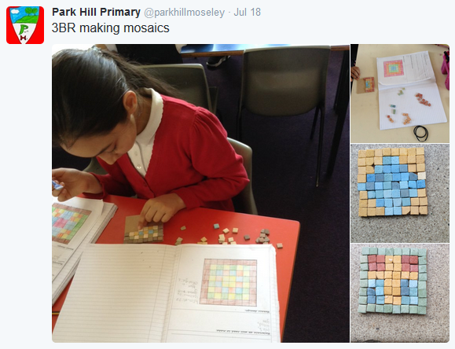
Keeping informed:
Instagram
Newsletter

Slide 18
Online safety
Technology provides opportunities for:
Learning
Fun
Friendship
When online, however, children are more at risk of being involved in:
Bullying
Exploitation
Showing negative behaviours towards others
FT

Slide 19
Online safety: what does the school do?
Promote positive use of technology/internet
Deliver lessons in e-safety through ProjectEVOLVE and RHE lessons
Address e-safety issues as they arrive
Provide advice to pupils and parents about staying safe online
Signposts to other sources of information
Technical solutions
FT

Slide 20
Online safety: how parents can support children
Talk to your child about how they use the internet
Ensure you know what their online activities are:
  How age appropriate are games?
  What are they watching on YouTube?
  Which networks are they part of?
  Consider limiting the amount of time children remain online per day
IM

Slide 21
Thank you from all the staff!

