Slide 1
Year 4 Parents/Carers’ Meeting
8th September 2026

Slide 2
Morning Timetable
8:45 Year 4 line up next to Reception playground
8:50 – 9:00 register, early work (spellings, handwriting, times tables) and assembly
9:00 – 9:45 reading
9:45 – 10:45 writing
10:45 – 11:10 music/times tables, SPaG, spellings
11:10 – 11.25 BREAK
11:30 – 12:30 maths

Slide 3
Afternoon Timetable
Monday outdoor PE, RHE/PATHS (My Happy Mind)
Tuesday science, Spanish
Wednesday art/DT, indoor PE
Thursday history/geography, computing
Friday RE/RHE/PATHS

Slide 4
Year 4 Humanities
Autumn 1 The Romans
Autumn 2 Geographical features of the UK and Europe
Spring 1 The Anglo-Saxons and their legacy
Spring 2 Catalonia (Spain) & UK – a comparative study
Summer 1 Vikings versus Anglo-Saxons
Summer 2 Mexico & UK – a comparative study

Slide 5
English
Writing: letters, narratives, argument text, recounts, poetry,
Reading: The Queen of Darkness*, Beowulf the Hero, How to Train Your Dragon,
Toro! Toro!
*new text based on Romans

Slide 6
Maths
Place Value and Number e.g. addition and subtraction
Measurement e.g. length and perimeter
Statistics e.g. bar charts
Geometry e.g. shape

Slide 7
Homework
Reading records – hand in with FIVE entries
Spellings
Maths/Times tables practice
All homework is set on Friday to be completed for the following Friday

Slide 8
The Benefits of Reading For Pleasure
Evidence Shows:
Positive relationship between reading enjoyment and attainment
Positive link between positive attitudes towards reading and scoring well in assessments
Reading for pleasure has positive emotional and social consequences
Reading for enjoyment is one of the most important factors for educational success

Slide 9
Multiplication Tables Check
The multiplication tables check (MTC) is statutory for primary schools from 2021/22 academic year.
The purpose of the MTC is to determine whether pupils can recall their times tables fluently, which is essential for future success in mathematics. It will help schools to identify pupils, who have not yet mastered their times tables so that additional support can be provided.
Schools must administer the MTC to all eligible year 4 pupils across a two-week period from week beginning Monday 7th June.
https://www.timestables.co.uk/multiplication-tables-check/

Slide 10
UNIFORM
Please ensure that your child is wearing a full school uniform every day including BLACK SHOES.
Please ensure your child comes in PE kit on PE days (white t-shirt, black shorts, leggings or track suit, pumps, trainers – no football shirts).
Remember: no earrings/watches on PE days (Monday and Wednesday).
Dressing up days will be announced through the year.
Please provide your child with a large reusable bottle of PLAIN water for during the school day.

Slide 11
TRIPS
Synagogue – Jewish place of worship
Hindu temple
Dates /times etc TBC

Slide 12
Attendance and Punctuality
Children can earn extra playtime for 98% attendance or better.
Early work/assembly begins at 8.50am so be in the line at 8:45am!

Slide 13
Park Hill is a compassionate school
What - Promoting compassion in our school
Who – Staff, pupils, parents
Why – to make the school a happier, safer place, to keep focus on charity, to encourage good citizenship in children, to promote good behaviour.

Slide 14



Slide 15
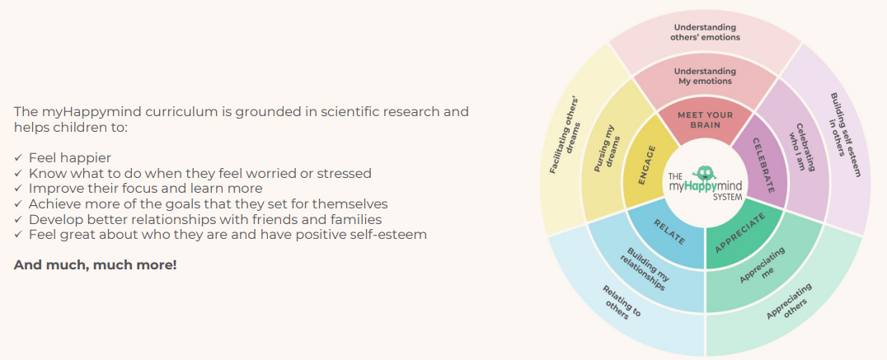

Slide 16

UNICEF Rights Respecting School Award
Here at Park Hill, we are now a GOLD UNICEF Rights Respecting School. We put the UN Convention for the Rights of the Child (UNCRC) at the heart of our school ethos and culture to improve well-being and develop every child’s talents and abilities to their full potential.
Our children and the school community learn about children’s rights and how to put them into practice every day.
Each class has learned about the UN Convention for the Rights of the Child (UNCRC) and created a class charter.

Slide 17
Photo permission
Books / Instagram
Why?
to create a record of learning
to promote the school
to build a presence in the local community
to share successes with parents and carers

Slide 18
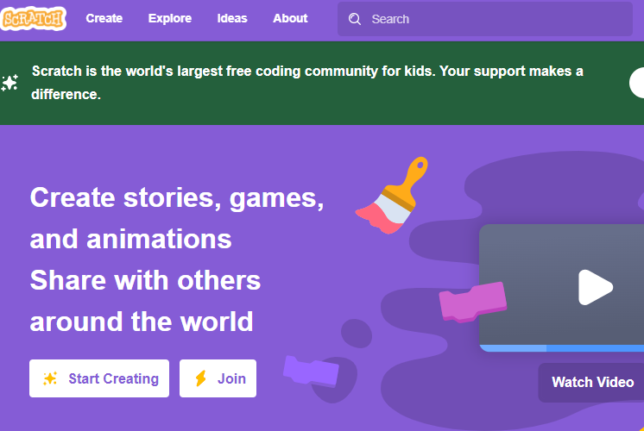


Technology

Slide 19
Online safety: an increasing priority
Technology provides opportunities for:
Learning
Fun
Friendship
When online, however, children are more at risk of being involved in:
Bullying
Showing negative behaviours towards others

Slide 20
Online safety: what does the school do?
Promote positive use of technology/internet
Deliver lessons in e-safety through Project EVOLVE and RHE lessons
Address e-safety issues as they arrive
Provide advice to pupils and parents about staying safe online
Signpost to other sources of information

Slide 21
Online safety: how parents can support children
Talk to your child about how they use the internet
Ensure you know what their online activities are:
  How age appropriate are games?
  What are they watching on YouTube or any other social media platform?
  Which networks are they part of?
  Consider limiting the amount of time children remain online per day.

Slide 22
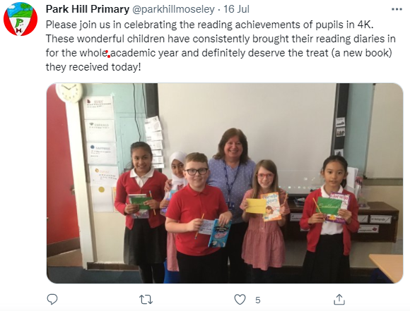
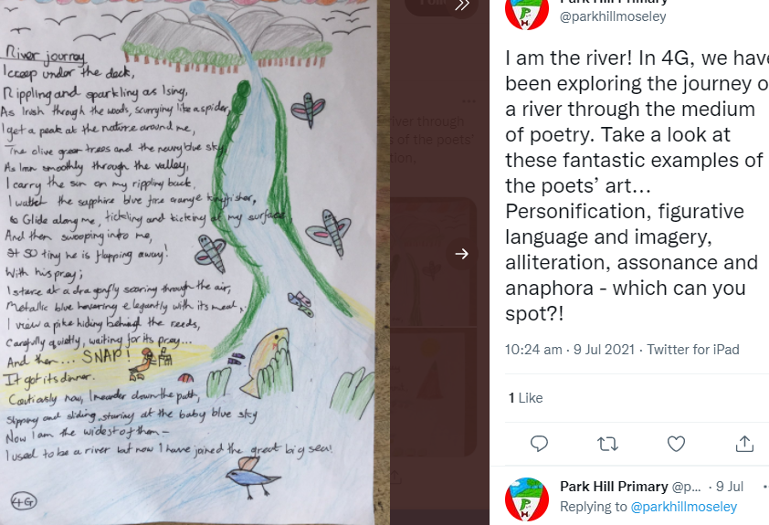
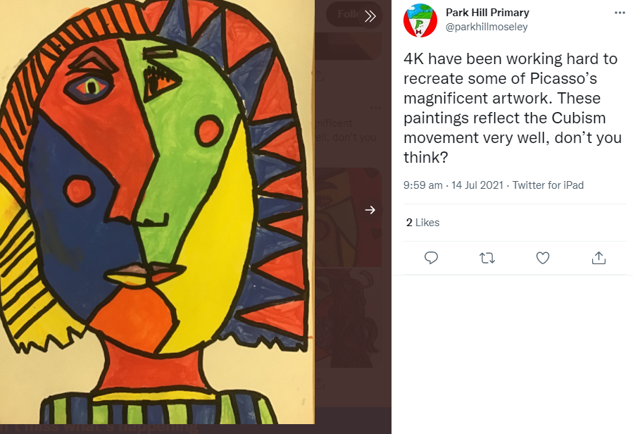
Celebrating Success – Instagram - @parkhillmoseley

Slide 23
Thank you for attending.
Any questions.

