Slide 1
Year 3 Parents/Carers’ Meeting
8th September 2026

Slide 2
Morning Timetable
8:45 In the line at the back of school
8:50 – 9:00 Register and assembly
9:00 – 10:00 Maths
10.00 – 10:45 Reading
10:45 – 11:10 RHE/PATHS/Spelling/Phonics/Spanish
11:10 – 11.25 *Snack/Playtime
11:30 – 12:30 Writing
12:30 Lunch
*snack is not provided, no nuts

Slide 3
Afternoon Timetable
Monday Art/DT
Tuesday Science and Music
Wednesday Indoor PE and RE
Thursday Outdoor PE and Computing
Friday History/Geography

Slide 4
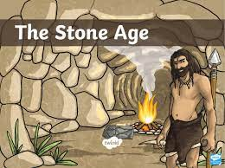
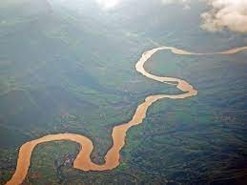
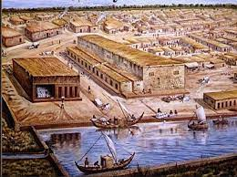
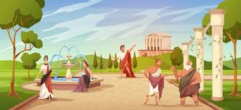
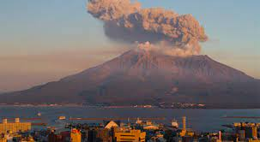
Year 3 Humanities
Autumn 1 How did life change from The Stone Age to the Iron Age?
Autumn 2 Rivers
Spring 1 The achievements of the Indus Valley civilisation
Spring 2 Geographical features of European countries
Summer 1 Ancient Greece
Summer 2 Volcanoes and Earthquakes

Slide 5






English
Writing: Setting descriptions, narratives, instructions, diary entries and recounts.
Reading: Stone Age Boy, Wind in the Willows, Nadiya Bakes, Planet Omar, The Odyssey, The firework Maker’s Daughter

Slide 6




Maths
Number- Place Value, Addition, Subtraction, Multiplication and Division
Fractions
Measurement- Time, Money
Geometry- Shape
Statistics

Slide 7

myHappymind
Mental health focussed assemblies weekly.

Slide 8
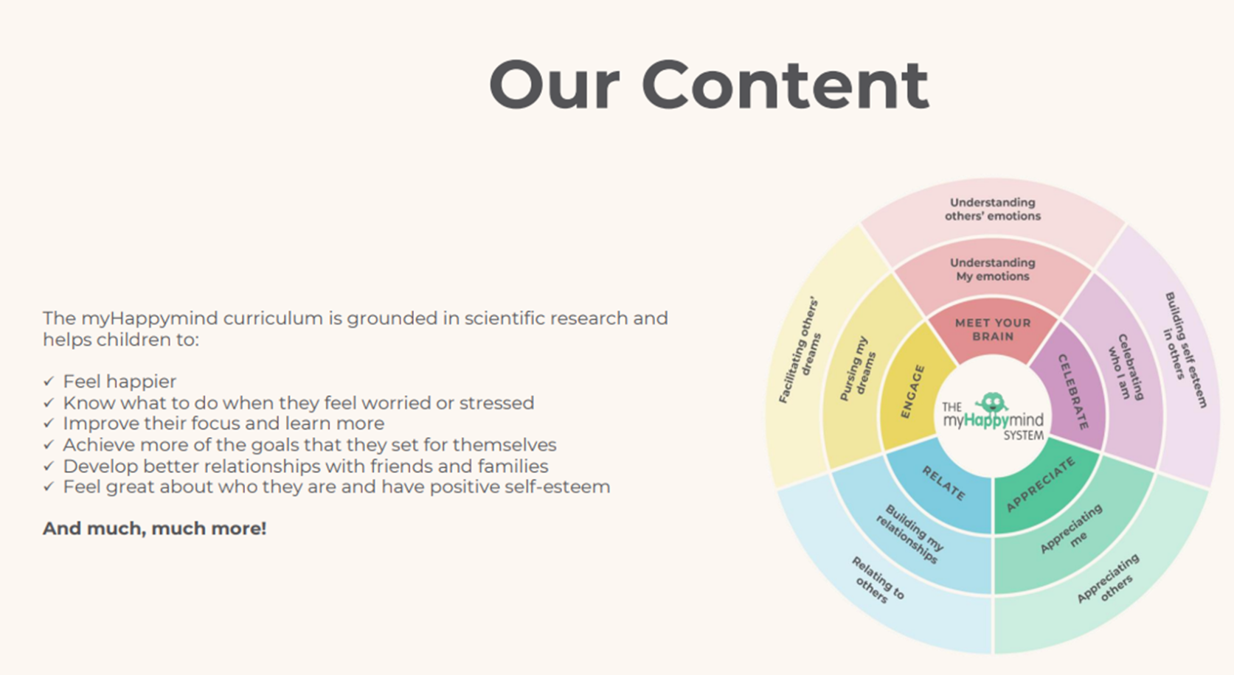

Slide 9
Homework
Reading (records) – hand in with FIVE entries
Spellings – Year 3/4 common exception words
Maths/Times tables practice
SPAG sheet
All homework is set on Friday to be completed for the following Friday.

Slide 10
UNIFORM
Please ensure that your child is wearing a full school uniform every day including BLACK SHOES.
Please ensure your child comes in PE kit on PE days (white t-shirt, black shorts, leggings or track suit, pumps, trainers – no football shirts).
Remember: no earrings/watches on PE days
Dressing up days will be announced through the year.
Please provide your child with a bottle of PLAIN water for school day.

Slide 11
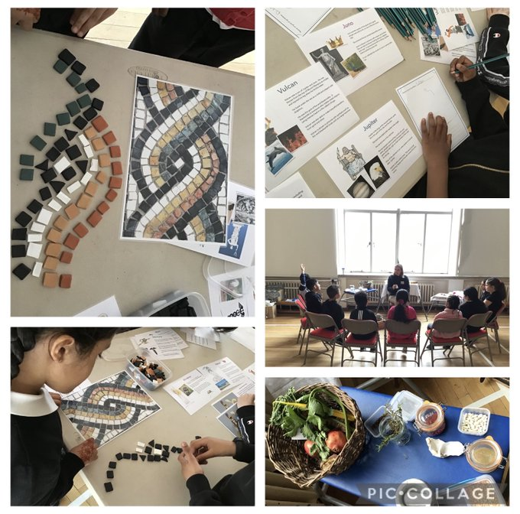
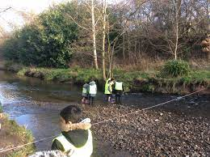
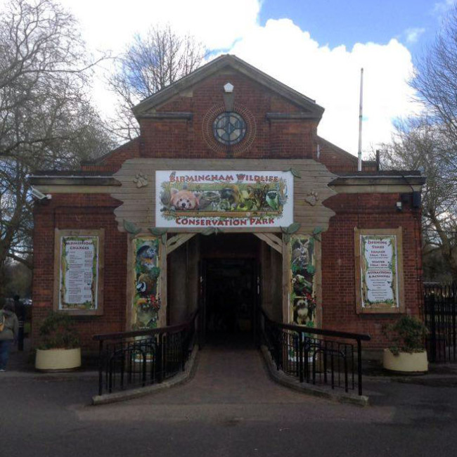
TRIPS and WORKSHOPS
Cannon Hill river study
The Stone Age workshop in school
Synagogue – Jewish place of worship

Slide 12
Park Hill is a compassionate school
What - Promoting compassion in our school
Who – Staff, pupils, parents
Why – to make the school a happier, safer place, to keep focus on charity, to encourage good citizenship in children, to promote good behaviour.

Slide 13

UNICEF Rights Respecting School Award
Here at Park Hill, we are a Gold UNICEF Rights Respecting School. We put the UN Convention for the Rights of the Child (UNCRC) at the heart of our school ethos and culture to improve well-being and develop every child’s talents and abilities to their full potential. Our children and the school community learn about children’s rights and how to put them into practice every day.
Each class has learned about the UN Convention for the Rights of the Child (UNCRC) and created a class charter.
You can find out more about the UNCRC at https://www.unicef.org.uk/what-we-do/un-convention-child-rights/?gclid=CPHVpv3iqNQCFU0Q0wodS9oCGg&sissr=1
Talk homework in the newsletter.

Slide 14
Attendance and Punctuality
Children can earn certificates for 98% attendance or better.
Early work/assembly begins at 8.50am so be in the line at 8:45am!
School finishes at 3:20pm.

Slide 15



Technology

Slide 16
Online safety: an increasing priority
Technology provides opportunities for:
Learning
Fun
Friendship
When online, however, children are more at risk of being involved in:
Bullying
Showing negative behaviours towards others

Slide 17
Online safety: what does the school do?
Promote positive use of technology/internet
Deliver lessons in e-safety through Project EVOLVE and RHE lessons
Address e-safety issues as they arrive
Provide advice to pupils and parents about staying safe online
Signpost to other sources of information

Slide 18
Online safety: how parents can support children
Talk to your child about how they use the internet
Ensure you know what their online activities are:
  How age appropriate are games?
  What are they watching on YouTube or any other social media platform?
  Which networks are they part of?
  Consider limiting the amount of time children remain online per day.

Slide 19
Thank you for attending!
Questions?

