Slide 1
Year 2 Parents/Carers’ Meeting
9th September 2026

Slide 2
Morning Timetable
8:50 – 9:00 Register and assembly
9:00 – 9:30 Whole class phonics
9.30 – 10:20 Writing
10:20- 10:30 Morning break
10:30 – 11:30 Maths
11:30 – 12:30 Dinner time

Slide 3
Afternoon Timetable
Guided Reading (every afternoon)
Monday Indoor PE, Art/DT
Tuesday Science and Outdoor PE
Wednesday Geography/History
Thursday RE and Music
Friday SPaG and Computing

Slide 4
Year 2 Humanities
Autumn 1 The similarities and differences between Coll and Tobago.
Autumn 2 Guy Fawkes.
Spring 1 Using maps around school and the locality.
Spring 2 Mary Seacole and Rosa Parks.
Summer 1 Christopher Columbus and Neil Armstrong.
Summer 2 Cricket at Edgbaston.

Slide 5



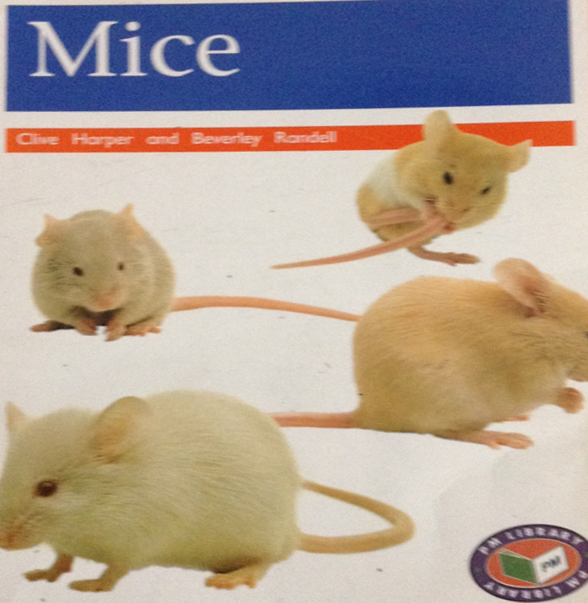
English
Writing: Setting descriptions, narratives, instructions, diary entries and recounts.
Reading: Mice, Katie Morag and the Two Grandmothers, Katie Morag Delivers the Mail, The Majic Paintbrush, Beware of girls and Didgi Duck.

Slide 6
UNIFORM
Please ensure that your child is wearing a full school uniform every day including BLACK SHOES.
Please ensure your child comes in PE kit on PE days (white t-shirt, black shorts, leggings or track suit, pumps, trainers – no football shirts).
Remember: no earrings/watches on PE days
Dressing up days will be announced through the year.
Please provide your child with a bottle of PLAIN water for the school day.

Slide 7
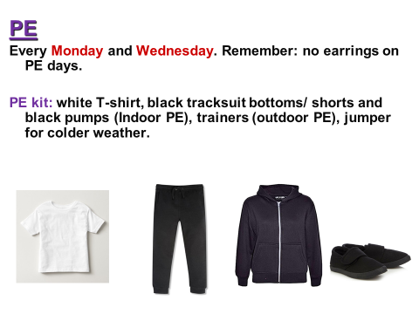
PE
Every Monday and Tuesday.
Remember: no earrings on PE days and tie hair back.

Slide 8
In PE, pupils take part in multi skills, cricket, football, dance and gymnastics.
At the end of a unit of PE, we take part in a competition. This help pupils to understand competition rules.

Slide 9
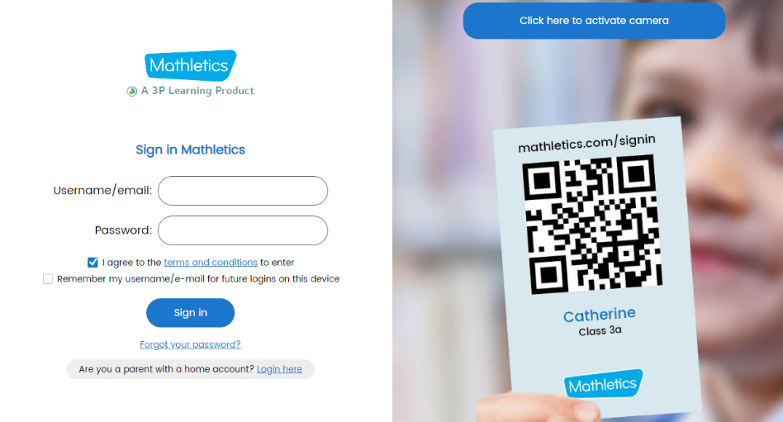
Homework
All homework is set on Friday to be completed for the following Friday.
Reading (records) – hand in with FIVE entries
Handwriting practice/spellings
Maths

Slide 10
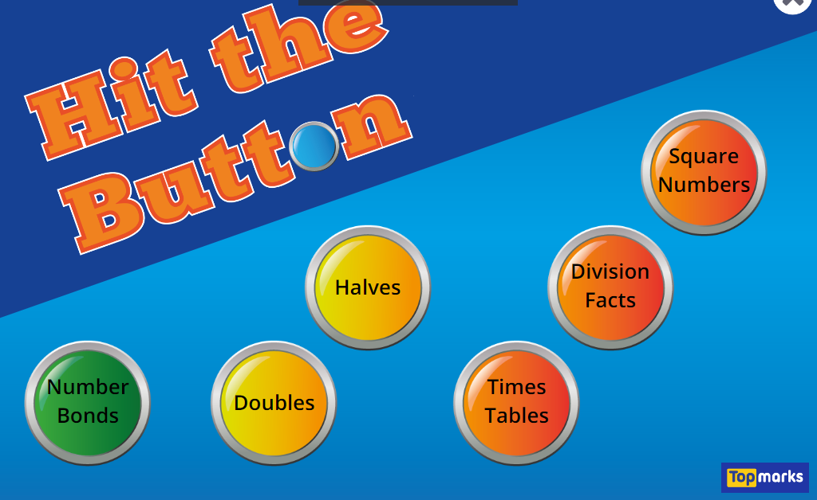
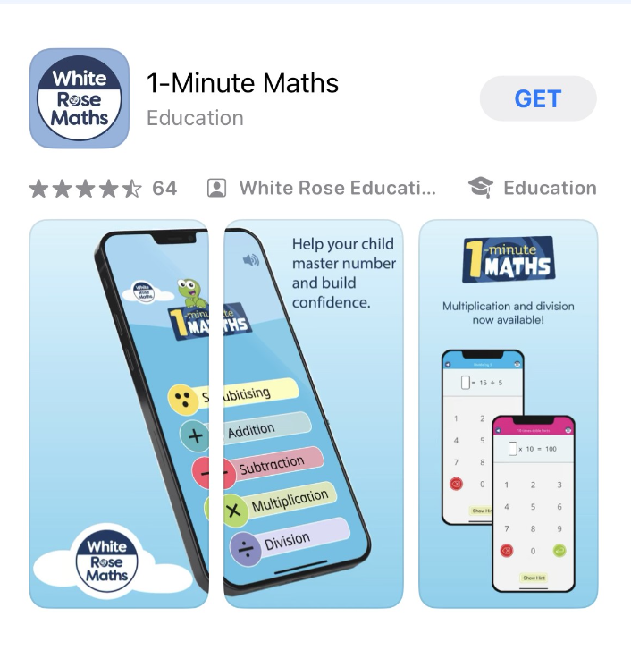
Maths
Number- Place Value, Addition, Subtraction, Multiplication and Division
Measurement- Time, Money
Geometry- Shape
Statistics

Slide 11

myHappymind
New mental health focussed assemblies weekly.

Slide 12
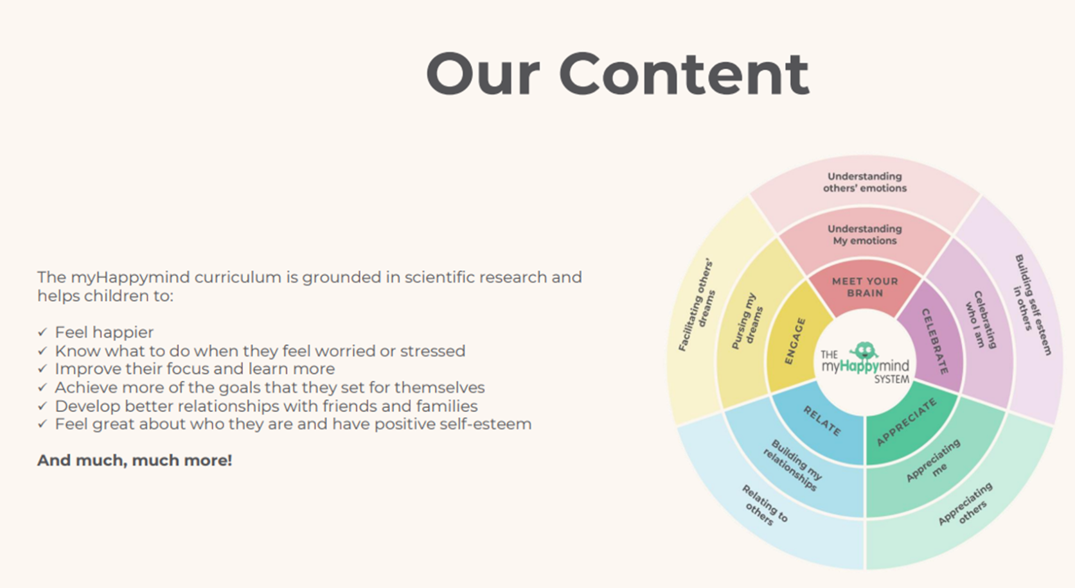

Slide 13
Park Hill is a compassionate school
What - Promoting compassion in our school
- compassion certificates and RHE lessons
Who – Staff, pupils, parents
Why – to make the school a happier, safer place, to keep focus on charity, to encourage good citizenship in children, to promote good behaviour.

Slide 14

UNICEF Rights Respecting School Award
Here at Park Hill, we are a Gold UNICEF Rights Respecting School. We put the UN Convention for the Rights of the Child (UNCRC) at the heart of our school ethos and culture to improve well-being and develop every child’s talents and abilities to their full potential. Our children and the school community learn about children’s rights and how to put them into practice every day.
Each class has learned about the UN Convention for the Rights of the Child (UNCRC) and created a class charter.
You can find out more about the UNCRC at https://www.unicef.org.uk/what-we-do/un-convention-child-rights/?gclid=CPHVpv3iqNQCFU0Q0wodS9oCGg&sissr=1
UNICEF website

Slide 15
Photo permission
Books / Instagram
Why?
to create a record of learning
to promote the school
to build a presence in the local community
to share successes with parents
Inform the office of your choice

Slide 16
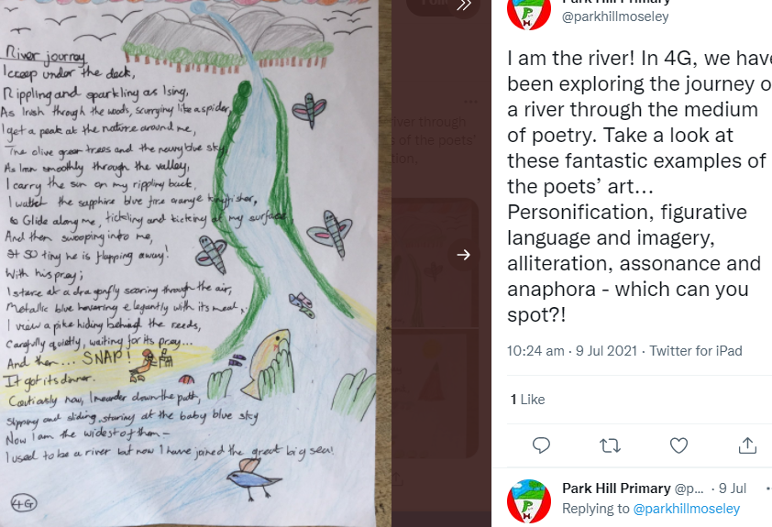
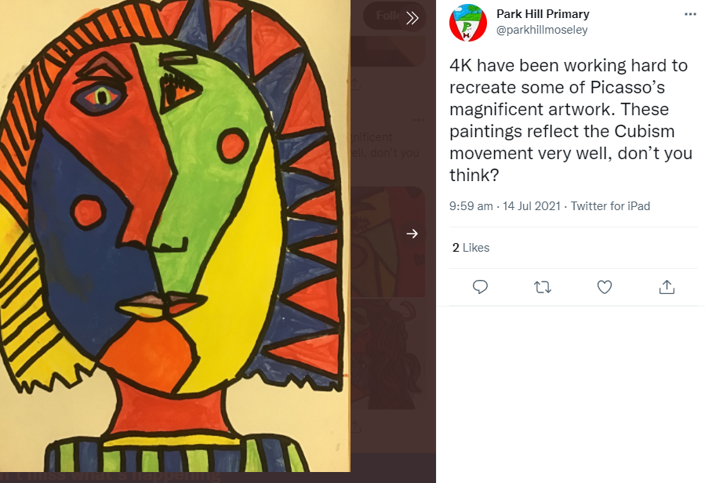
Celebrating Success - Instagram
KK

Slide 17
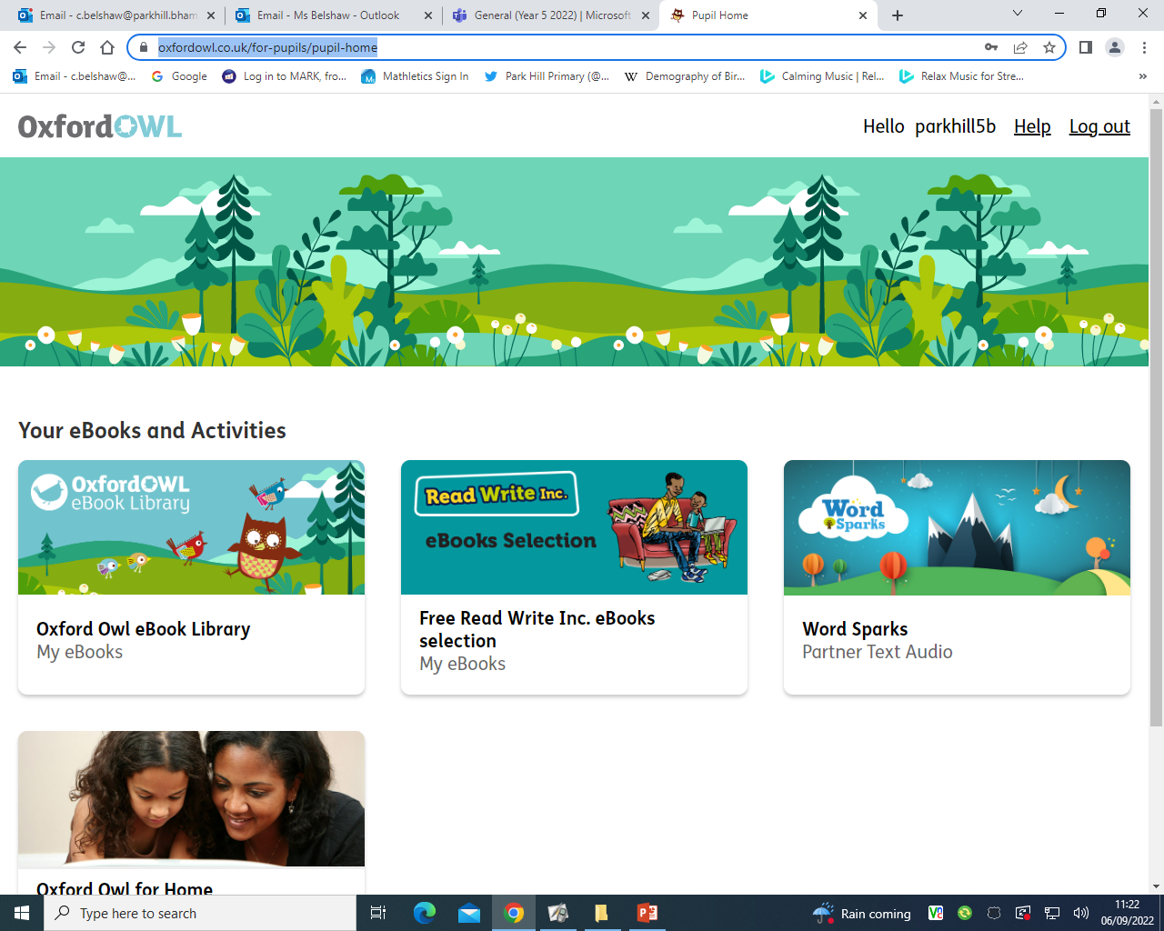



Technology

Slide 18
Online Safety: an increasing priority
Technology provides opportunities for:
Learning
Fun
Friendship
When online, however, children are more at risk of being involved in:
Bullying
Showing negative behaviours towards others

Slide 19
Online safety: what does the school do?
We promote positive use of technology/internet
Deliver lessons in e-safety through ProjectEVOLVE and RHE lessons
Address online-safety issues as they arrive
Provide advice to pupils and parents about staying safe online

Slide 20
Online safety: how parents can support children
Talk to your child about how they use the internet
Ensure you know what their online activities are:
  How age appropriate are games?
  What are they watching on YouTube?
  Which networks are they part of?
  Consider limiting the amount of time children remain online per day.

Slide 21
Attendance and Punctuality
Children can earn certificates for 98% attendance or better.
Early work/assembly begins at 8.50am Be in the line at 8:45am!

Slide 22
Thank you for attending today.

