Slide 1
Year 1 Parents/Carers’ Meeting
9th September 2026

Slide 2
Attendance and Punctuality
Early work/assembly begins at 8.50am so be in the line at 8:45am!

Slide 3
Morning Timetable
8:45 In the line
8:50 – 9:00 Register and assembly
9:00 – 9.30 Phonics
9.30 – 10:30 Writing
10:30 – 11:30 Maths
*Snack/Playtime when required

Slide 4
Afternoon Timetable
12.30- 12.50 Phonics
12.50 – 3.20 Guided Reading & Foundation subject
*Playtime when required

Slide 5
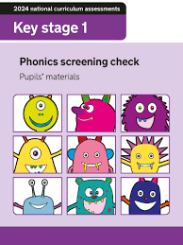
Phonics
Children have daily phonics lessons to build strong reading skills.
In daily reading lessons, children read with the teacher regularly.
At the end of the year, there will be a mandatory phonics check.
The check assesses your child’s ability to decode words using phonics skills.

Slide 6




Writing
Our writing is based around traditional stories and stories with repeating language.
Children will experience writing a range of genres; instructions, letters and narratives.

Slide 7
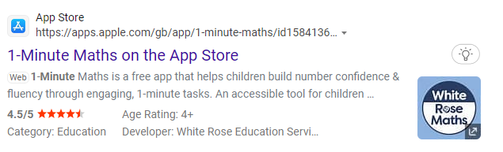
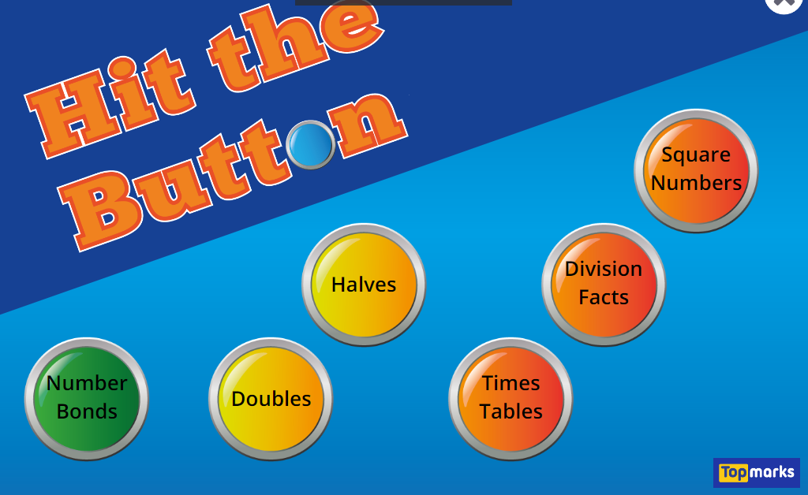
Maths
Number- Place Value, Addition, Subtraction, Multiplication and Division
Fractions
Measurement- Time, Money
Geometry- Shape
Statistics

Slide 8
Homework
Reading- One banded book and one free choice
Handwriting/Spellings
Maths
All homework is set on Friday to be completed for the following Friday.

Slide 9

UNIFORM
Please ensure that your child is wearing a full school uniform every day including BLACK SHOES.
Please ensure your child comes in PE kit on PE days (white t-shirt, black shorts, leggings or track suit, pumps, trainers – no football shirts).
Remember: no earrings/watches on PE days (Monday and Thursday).

Slide 10

myHappymind
Mental health focussed assemblies weekly.

Slide 11
Park Hill is a compassionate school
What - Promoting compassion in our school
Who – Staff, pupils, parents
Why – to make the school a happier, safer place, to keep focus on charity, to encourage good citizenship in children, to promote good behaviour.

Slide 12

UNICEF Rights Respecting School Award
Here at Park Hill, we are a Gold UNICEF Rights Respecting School. We put the UN Convention for the Rights of the Child (UNCRC) at the heart of our school ethos and culture to improve well-being and develop every child’s talents and abilities to their full potential. Our children and the school community learn about children’s rights and how to put them into practice every day.
Each class has learned about the UN Convention for the Rights of the Child (UNCRC) and created a class charter.
You can find out more about the UNCRC at https://www.unicef.org.uk/what-we-do/un-convention-child-rights/?gclid=CPHVpv3iqNQCFU0Q0wodS9oCGg&sissr=1

Slide 13
Year 1 and 2 Phonics Workshop
Wednesday 23rd September 2026
9am

