Slide 1
Year 6 Parents’
Meeting
2026
Park Hill Primary
KK

Slide 2
Year 6 Team
Miss Marsden and Mrs Tariq - Class Teachers
Mrs Tanveer – Teaching Assistant
Mr Malcolm – maths group
Mr Khan & Mrs Gill – Learning Mentors
Rukaiya & Gazala- Supervisors

Slide 3
Attendance and Punctuality
Pupils should arrive at 8.45 ready to start at 8.50!
- 98% at least attendance in a half term

Slide 4
Morning Timetable
8.45am – Arrive and early work
9.00am – Assembly
9.10am – Reading
10.10am – Maths
11.10am – Break
11.25am - Writing
IM

Slide 5
Afternoon Timetable
Monday: science, Music, RHE/PATHS
Tuesday: Computing, Spanish, RHE/PATHS
Wednesday: history/ geography, SPAG
Thursday: RE & PE
Friday: art/DT & PE

Slide 6
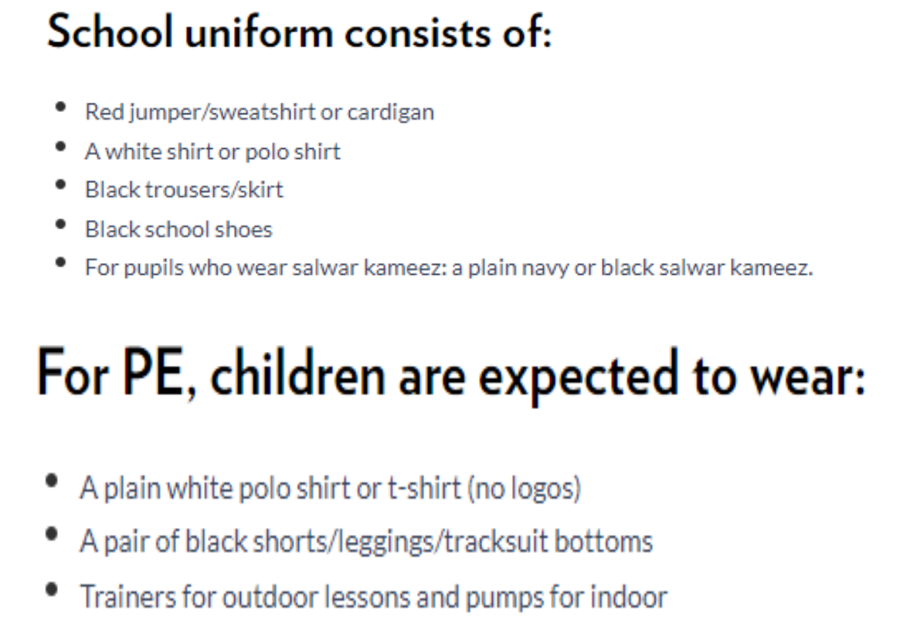
Uniform

Slide 7
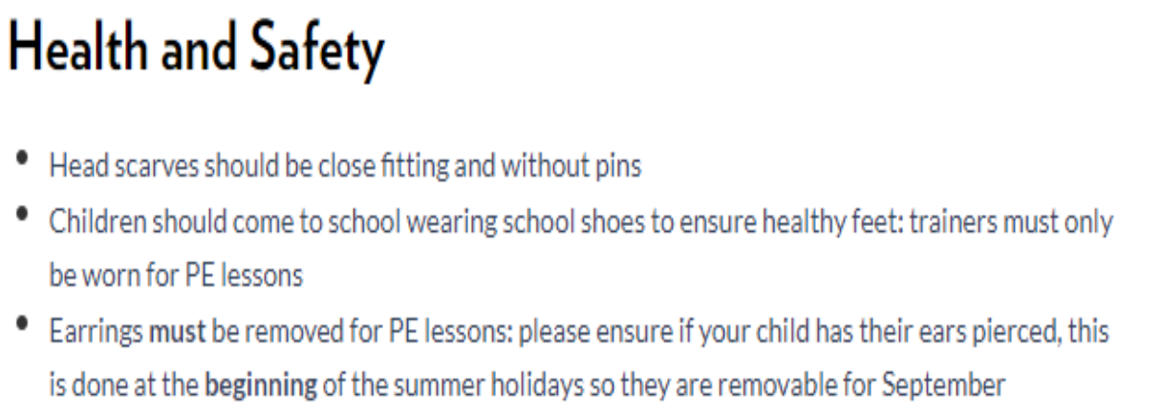

Slide 8
Year 6 Humanities Units of Work
Autumn 1: Where in the World is Kensuke’s Kingdom?
Autumn 2: World War Two
Spring 1: How are mountains formed?
Spring 2: SATs preparation
Summer 1: The Islamic Golden Age
Summer 2: Norfolk

Slide 9
English: Writing genres
Narrative and descriptive pieces
Letters
Diaries
Newspaper reports
Guides
Reports
Arguments
Poetry

Slide 10
English: Reading texts
Macbeth and Hamlet: Shakespeare
Brightstorm: Vashti Hardy
Kensuke’s Kingdom: Michael Morpurgo
Goodnight Mr Tom: Michelle Magorian

Slide 11
Book Banding
Dark Blue → Dark Red → Black

Slide 12
Maths Units Covered
Number
Measures
Statistics
Geometry
Ratio
Algebra

Slide 13
Homework
Reading: daily
Reading diaries: 5 entries on a Thursday
Spellings: test on Tuesday
English and Maths: Friday to Wednesday

Slide 14
The Benefits of Reading For Pleasure
Evidence Shows:
Positive relationship between reading enjoyment and attainment
Positive link between positive attitudes towards reading and scoring well in assessments
Reading for pleasure has positive emotional and social consequences
Reading enjoyment is one of the most important factors for educational success

Slide 15
UNICEF: Rights Respecting School Gold
We will be putting the UN Convention for the Rights of the Child (UNCRC) at the heart of our school ethos and culture to improve well-being and develop every child’s talents and abilities to their full potential. Our children and the school community will learn about children’s rights and how to put them into practice every day.

Slide 16
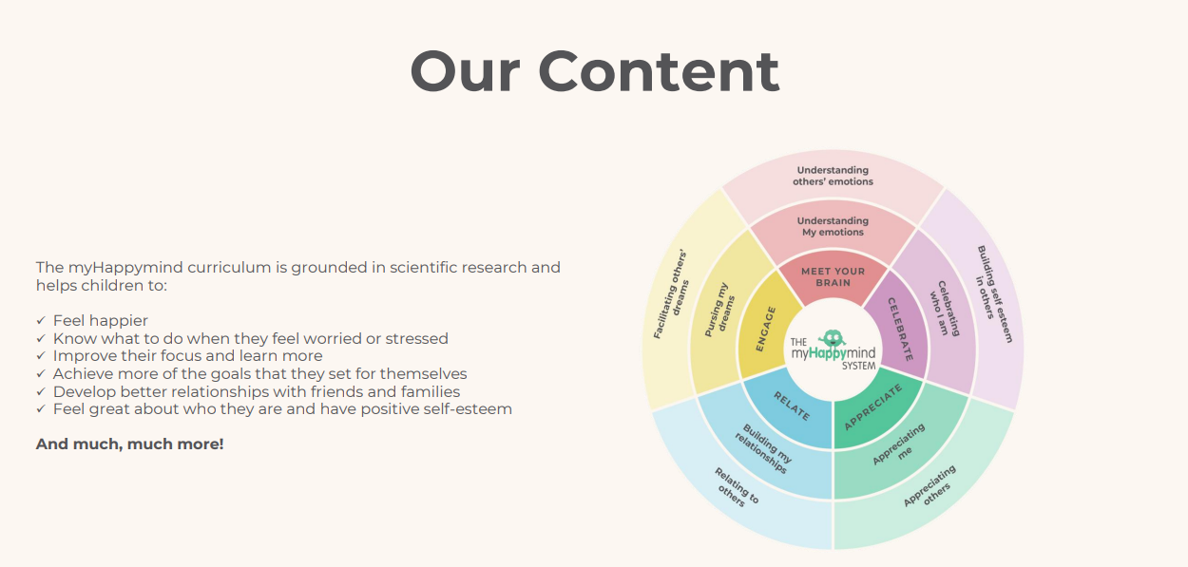
My Happy Mind

Slide 17
SATs 2027
Scheduled for the week of the 10th May 2027
Tests in Reading, SPaG and Maths
Writing is assessed by teachers and moderated
SATs meeting in Spring to give more detailed information

Slide 18
Online safety: an increasing priority
Technology provides opportunities for:
Learning
Fun
Friendship
When online, however, children are more at risk of being involved in
Bullying
Grooming & exploitation
Showing negative behaviours towards others

Slide 19
Online safety: what does the school do?
Promote positive use of technology/internet
Deliver lessons in online safety through ProjectEVOLVE and RHE lessons
Address online safety issues as they arrive
Provide advice to pupils and parents about staying safe online
Signposts to other sources of information
Technical solutions

Slide 20
Online safety: how parents can support children
Talk to your child about how they use the internet
Ensure you know what their online activities are:
  How age appropriate are games?
  What are they watching on YouTube?
  Which networks are they part of?
  Consider limiting the amount of time children remain online per day

